Slide 2
Define economics and discuss the evolving global economic crisis
Analyze the impact of fiscal and monetary policy on the economy
Explain and evaluate the free market system and supply and demand
Explain and evaluate planned market systems
Describe the trend toward mixed market systems
Discuss key terms and tools to evaluate economic performance

Slide 3
Understanding Economics: Key Definitions
Economy: Financial and social system of how resources flow through society
Economics: Study of choices made to allocate society’s resources
  Macroeconomics: Study of a country’s overall economic dynamics
  Microeconomics: Study of smaller economic units

Slide 4
Global Economic Crisis
Began when the dotcom bubble burst in 2000, followed by the 9/11 terrorist attacks in 2001
  Stock market dropped
  Unemployment rose
  Brink of recession
Subprime mortgage loans - Granted to borrowers with low credit scores
  Introduced to aid investments

Slide 5
Economic Relief
Troubled Assets Relief Program (TARP)
  Introduced as an economic bailout plan
To help the nation from a financial disaster the government passed the American Recovery and Reinvestment Act
  Included cutting taxes, building infrastructure, and investing in green energy

Slide 6
Fiscal Policy
Government efforts to influence the economy through taxation and spending
  Debt ceiling - Maximum amount Congress lets the government borrow
  Fiscal cliff - Decrease in government spending and increase in tax rates

Slide 7
Outcomes of Budget
Budget surplus
Overage that occurs when revenue is higher than expenses over a given period of time
Budget deficit
Shortfall that occurs when expenses are higher than revenue over a given period of time
Federal debt
Sum of all the money that the federal government has borrowed over the years and not yet repaid

Slide 8
Monetary Policy
Federal Reserve decisions that shape the economy by influencing interest rates and the supply of money
  M1 money supply: Includes all currency plus checking accounts and traveler’s checks
  M2 money supply: Includes all M1 money supply and saving accounts, money market accounts, and certificates of deposit

Slide 9
Tools Used by the Federal Reserve to Expand and Contract the Money Supply
Open market operations
Federal Reserve function of buying and selling government securities
Discount rate
Rate of interest that the Federal Reserve charges when it loans funds to banks
Reserve requirement
Rule set by Fed, which specifies the minimum amount of reserves a bank is required to hold

Slide 10
Capitalism (Free Market System)
Economic system based on:
  Private ownership - Right to own business and keep after-tax profits and to private property
  Economic freedom - Right to free choice
  Fair competition

Slide 11
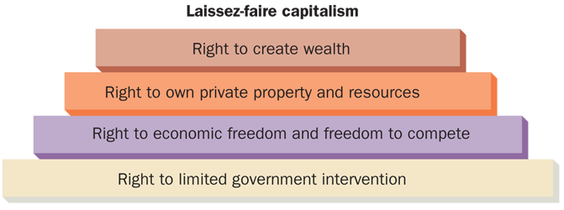
Basic Assumptions for Adam Smith’s
Laissez-Faire Capitalism
FIGURE 1-4

Slide 12
Degrees of Competition
Pure: Many competitors selling identical products
Monopolistic: Many competitors selling differentiated products
Oligopoly: Handful of competitors selling products that can be similar or different
Monopoly: One producer dominating the industry, leaving no room for competitors

Slide 13
Fundamental Principles of a Free Market System
Supply: Quantity of products that producers are willing to offer for sale at different market prices
  Supply curve
Demand: Quantity of products that consumers are willing to buy at different market prices
  Demand curve
Equilibrium price: Quantity demanded of a product equals the quantity supplied

Slide 14
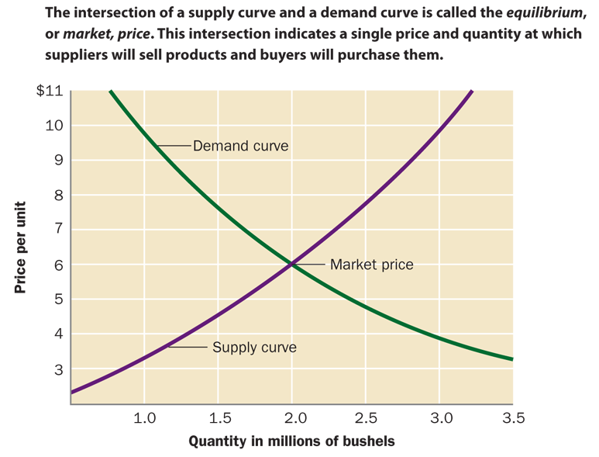
Supply Curve and Demand Curve
FIGURE 1-7

Slide 15
Types of Economic Systems (cont’d)
Differences in economic systems
  How they answer the four basic economic questions
    What goods and services will be produced?
    How will they be produced?
    For whom will they be produced?
    Who owns and controls the major factors
    of production?

Slide 16
Types of Economic Systems (cont’d)
Capitalism
  An economic system in which individuals own and operate the majority of businesses that provide goods and services
  Derived from Adam Smith’s laissez-faire capitalism in which a society’s best interests are served by individuals pursuing their own self-interest
    Creation of wealth is the concern of private individuals
    Resources used to create wealth must be privately owned
    Economic freedom ensures the existence of a free market economy
      Businesses and individuals decide what to produce and buy; the market determines quantities sold and prices
    Limited role of government

Slide 17
Planned Economies: Socialism and Communism
Socialism: Government should own and operate key enterprises that directly affect public welfare
Communism: Public ownership of all enterprises
  Under the direction of strong central government

Slide 18
Types of Economic Systems (cont’d)
Command economies
  Economic systems in which the government decides what will be produced, how it will be produced, who gets what is produced, and who owns and controls the major factors of production
  Socialism
    Key industries (e.g., transportation, utilities, and banking) are owned and controlled by the government
    Small-scale private businesses may be permitted and workers may choose their own occupations
    Production is based on national goals, and distribution is controlled by the state
    Intent is the equitable distribution of income, elimination of poverty, social services to all who need them, elimination of the economic waste of capitalistic competition

Slide 19
Types of Economic Systems (cont’d)
Command economies (cont’d)
  Communism
    All factors of production are owned and controlled by the government as proxy for ownership by all citizens
    Production is based on centralized state planning to meet the needs of the state and not necessarily the needs of its citizens
    The state dictates occupational choices and sets prices and wages
    Intent is to create Karl Marx’s concept of a classless society where all contribute according to their ability and receive benefits according to their needs.

Slide 20
Mixed Economies
Embody elements of planned and market-based economic systems
  Help in meeting the needs of all the citizens
Privatization: Process of converting government-owned businesses to private ownership

Slide 21
Evaluating Economic Performance
Gross domestic products (GDP)
  Total value of all final goods and services produced within a nation’s physical boundaries over a given period of time
Employment level
  Unemployment rate: Percentage of people in the labor force over age 16 who do not have jobs and are seeking employment
    Frictional and structural
    Cyclical and seasonal

Slide 22
Evaluating Economic Performance
Business cycle: Periodic contraction and expansion of the economy
  Contraction: Period of economic downturn
    Recession: Marked by a decrease in the GDP for two consecutive quarters
    Depression: Long-lasting recession
  Recovery: Period of rising economic growth
  Expansion: Period of strong economic growth

Slide 23
Evaluating Economic Performance
Price level - Measure used to evaluate the economic well-being
  Inflation: Period of rising average prices across the economy
    Hyperinflation: Average monthly inflation rate of more than 50 percent
    Disinflation: Period of slowing average price increases
    Deflation: Period of falling average prices

Slide 24
Evaluating Economic Performance
    Consumer price index (CPI): Evaluates the change in the weighted-average price of goods and services that the average consumer buys each month
    Producer price index (PPI): Evaluates the change over time in the weighted-average wholesale prices
Productivity: Relationship between production of goods and services and the resources required to produce them

Slide 25
Economics is the choices made to allocate society’s resources
Fiscal and monetary policies are used to improve the economic performance
Free market system is based on private ownership, economic freedom, and fair competition
  Supply and demand explain how the interaction between buyers and sellers directly affects the range of products and prices

Slide 26
In planned economies, economy is controlled by the government
Economies of the world are adapting mixed market systems to meet the needs of its citizens
Economic performance is evaluated by understanding gross domestic product, employment level, the business cycle, inflation rate, and productivity

